Slide 1


Welcome to the
Robinson TK & Kindergarten
Back to School Night
Mrs. Angela Bazos –(TK) – Room 1A
Ms. Megi Asano – Room 1B
Mrs. Dawn Fulton– Room 2

Slide 2

Welcome!
Parent Teacher Student Association (PTSA)
2022 – 2023 Co-Presidents:
Yea-Lan Chiang
Jenny Nugent

Slide 3


Slide 4


School Hours
August 24st – September 2nd
8:10am – 1 1:30am
September 6th – June 15th
8:10am – 1:30pm
All kindergarten minimum days
8:10am – 1 1:30am

Slide 5


Safety Information
DO NOT park in the circle in front of the school.
Please supervise your child before the door opens at 8:10. There is no running in the hallways, and they should not go behind the classrooms.
Students need to wear closed toed and closed heeled shoes. No Crocs!
Hats may be worn at recess, but not during class.

Slide 6
Pick-up
Students will be dismissed from the gate at the top of the ramp. Please wait on the other side of the gate and we will send your child to you.
EDP students will be dropped off and/or picked up before they reach the gate.
Students who are in an afterschool school class will also be picked-up by the MBX teachers.

Slide 7

School Supplies
If you would like to purchase school supplies from the PTSA, please write a check to the Robinson PTSA for $73.99 and and drop it off at the office. The supplies will then be delivered to the classroom. Thanks!

Slide 8

Parent Conferences
15 min. Welcome Assessments will be held Aug. 29th – Sept. 2nd. Please sign your child up for one.
The First Kindergarten Report Card will be sent home in January before conferences.
January 20^{th -} Kindergarten Conferences January 23rd - 27th .

Slide 9

General Kindergarten Schedule
8:10 Students come in the classroom (please be PROMPT!)
8:10 – 8:30 Morning Business: Attendance, Flag Salute and Calendar
8:30 – 9:15 Small Group Time: Thematic Groups, Word Work and Reading Instruction (2 parent volunteers are needed at this time to help lead a group)
9:15 – 9:45 Reader’s Workshop
9:45 – 10:20 Math
10:20 – 10:40 Snack Recess
10:40 – 1 1:35 Writer’s Workshop
1 1:35 – 1 1:45 Story
1 1:45 – 12:35 Lunch
12:35 – 1:05 Social Studies/Science/Math
1:05 – 1:30 Sight Word Free Choice
1:30 Dismissal

Slide 10


Snack & Lunch
Please make sure your child has a healthy snack each day. After Sept 5th, you may want to separate your child’s snack from their lunch.
Students will eat lunch at school beginning Sept. 6th. Please let your child know if they are buying lunch. Lunch orders need to be into the office by 9:00am.
Lunches will be free again this year. You can check out the choices on Café Counts.
No lunches the first 2 weeks of kindergarten.

Slide 11

Parent Volunteers
Please, please, please volunteer!
Sign-up for a day and time!
We need a Volunteer Coordinator!
Sign-in at the office and get a Volunteer Badge.
Please be on time!
If you are unable to come on your day, please try to find a substitute! We are depending on your help!
All volunteers must have a TB test. Please give results to the nurse.

Slide 12

Parent Volunteers
Parents that wish to volunteer in the classroom need to attend a Volunteer Training with Mrs. O’Sullivan.
The training dates are:
9/15 at 5-5:30

Slide 13

Other General Information
If your child is going to be absent from school, please call the office or e-mail the office and the teacher.
We need a note from a parent to send a child home with someone else. You may use the form on the cart in front of the classroom.
Consider buying a Robinson Riptide gear – Fridays are Spirit days!
Please put your child’s name on EVERYTHING!
Please join the PTSA & MBEF! The do so much for our students!

Slide 14
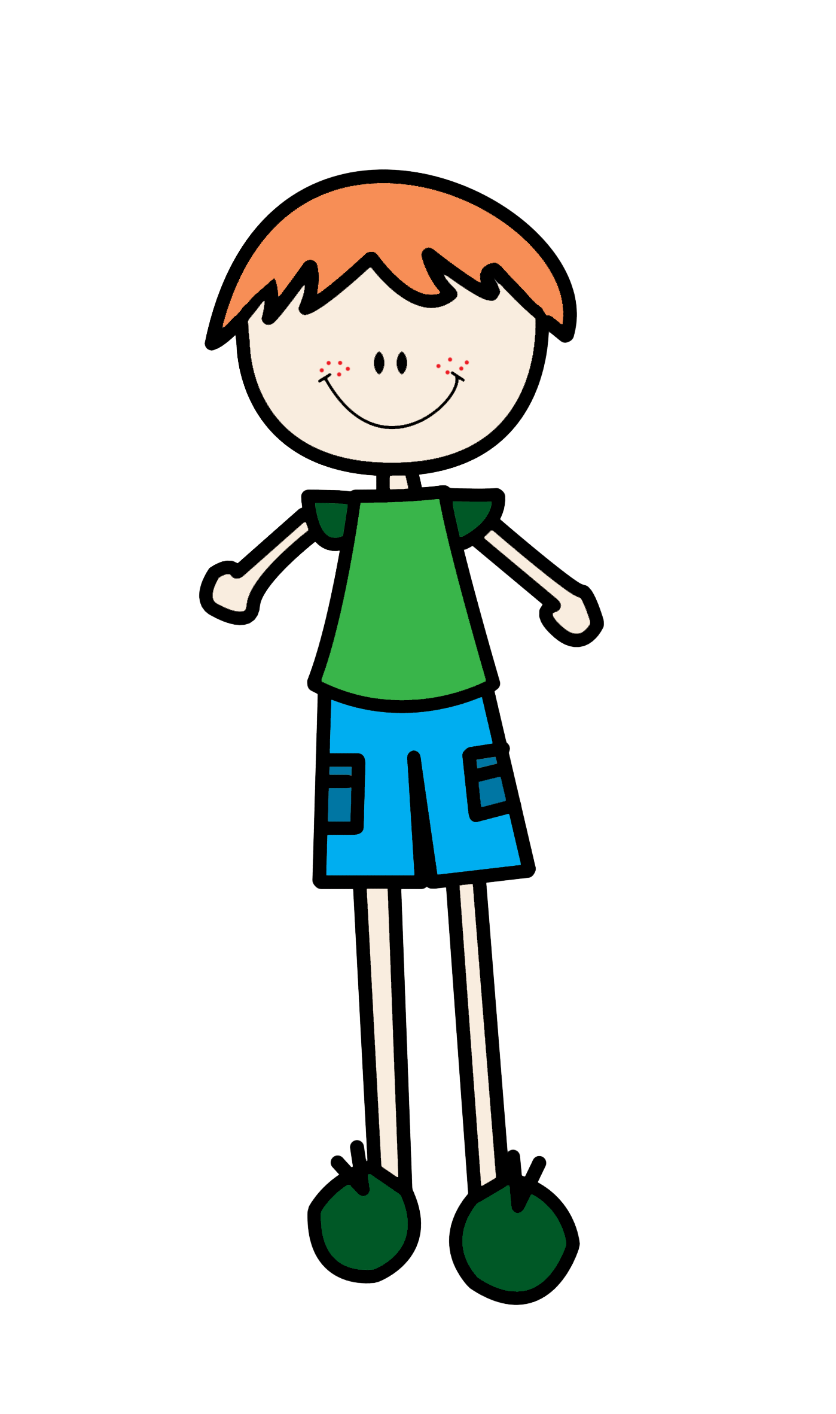

Parent Responsibilities
We are working together for our students!
Be prompt when dropping off and picking up your child.
Make sure your child has a healthy breakfast/lunch before you bring them to school.
Make sure that your child has 10-12 hours of sleep each night.
Send a small healthy snack. Remember they only have 20 minutes to eat and play!
Provide a safe & quiet place for students to do their homework.
Write a note when your child is absent from school.
Write a note if someone other than you is picking up.
Make sure you check your child’s folder & empty it daily!
Do NOT park in the loading zones!

Slide 15

Student Responsibilities
Put their own folders in the tub each day.
Hang their own backpacks on the hooks.
Remember to follow all the classroom rules and procedures.
Come to school prepared to learn!

Slide 16


Kindergarten

Slide 17

Class Management
A copy of the classroom rules is in your folder. After you have reviewed them with your child, please sign and have your child sign the contract then return it in your child’s folder.
We are using a program (app) called Classdojo. Information on how to sign-up is in your packet.
We will also use Dojo to send reminders, upload photos of your child, and send messages.

Slide 18

Kindergarten Website
www.robinsonkindergarten.com
Monthly homework packets to download
Monthly “Just For Fun” Calendars
General Calendar of Events
General Kindergarten Information
Individual Classroom Information

Slide 19

Reading at Home Program
Students will be required to read a minimum of 15 minutes per day. This includes reading books from school, favorites and Raz-kids stories.
Raz-Kids
  Classroom logins will be sent home soon.
  Find individual student name
  Students can progress at their own rate
  through the different reading levels.

Slide 20

Other Important Websites
Robinsonelementary.org
Mbusd.org
Raz-kids.com
Lexia Core 5
There are links to all the important kindergarten websites on our Kindergarten website.

Slide 21

Things You Can Work On
Pencil Grips!!!!
READ, READ, READ!!!!!
Write first & last names
Birthdays
Tying shoes
Phone numbers, especially parent’s cell number
Address

Slide 22
Curriculum

Slide 23

What is Reading Workshop?
A teaching method in which the goal is to explicitly teach students strategies to become more skillful at comprehending text.
Involves students in authentic reading experiences that focus on the strengths and needs of each individual student through differentiated instruction
Fountas and Pinnell Reading
Assessment identifies “just right
books” for each and every student
Notes:
This is the new reading curriculum that is replacing the Open Court basal reader.
Research shows that students need to read at least 60 minutes per day, Reading Workshop provides 20-40 (depending on the grade level) of that daily total
Based on over three decades of research
Columbia Teachers College

Slide 24

What is Writing Workshop?
Genres: Opinion Writing, Information, and Narrative
Fosters high-level thinking, including regular chances to synthesize, analyze, and critique
Develops and refines strategies for writing across the curriculum
Allows for student choice in
high-interest topics
Notes:
We are teaching the writer, not the piece/essay
Students are allowed to self select topics to write about within the given genre. This produces high-interest authentic writing.

Slide 25
Balanced Mathematics
Conceptual Understanding
Application
Procedural and Skill Fluency
Standards for Mathematical Practice
Notes:
The former CA Content Standards only had one set of math standards; however, with the Common Core there are two sets of math standards:
Standards for Mathematical Content
These standards are what students need to learn by grade level
Standards for Mathematical Practice
These eight standards are for all grades K-12 and tell us how we teach and how students should be engaged in the mathematics.
The Standards for Mathematical Practice, are the foundation for K-12 Balanced Mathematics. The emphasis used to be on procedural and skill fluency, but now procedural and skill fluency, conceptual understanding and application are equally valued and time is spent equally in these three areas to foster mathematical thinkers and problem solvers.

Slide 26

Cognitively Guided Instruction (CGI)
Three decades of research on how children develop mathematical thinking
Students are taught to explain their thinking
Multiple strategies (there isn’t just one
way to solve a problem!)
Promotes higher level thinking skills
Notes:
You can show the Children’s Mathematics: CGI book – Megan Franke is at UCLA and works directly with Center X who is providing our staff development
This style of teaching allows us to engage in a balanced approach to mathematics
Homework will shift to align with current brain research
This research has shown that children make deeper connections and foster greater conceptual understanding when they engage in 1-3 problems and solve them in multiple ways rather than a page of the same type of problem

Slide 27
Possible Field Trips
* Manhattan Beach Public Library
* MB Fire Station
* MB Police Station
*Possible Bus Trip – Aquarium
THANK YOU PTSA!!!

Slide 28
Thank you for coming!

